Slide 1
Building up an ESD centre on the Island of Samothraki, Greece
Lana Švab, B.A. Tourism Management, Slovenia
Mirjana Novak, M.Sc Chemistry, Croatia
Remziye Ekici, B.A. Tourism Management, Turkey
Mairi Pitiakoudi, Samothraki MAB, Greece

Slide 2
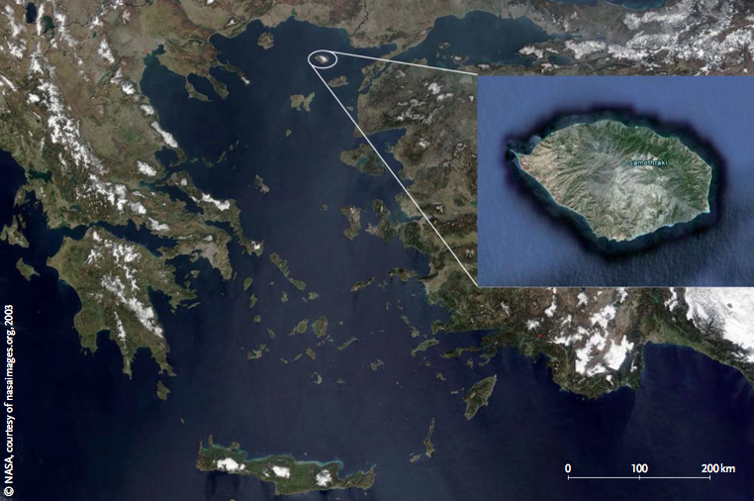
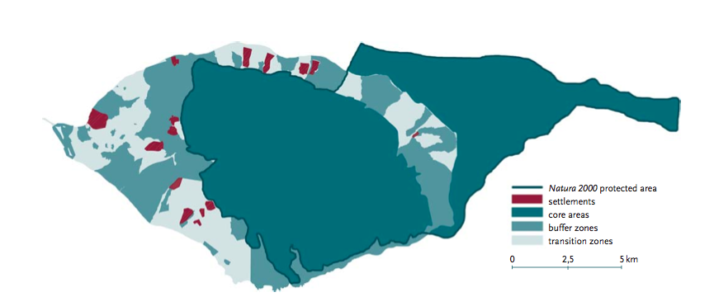
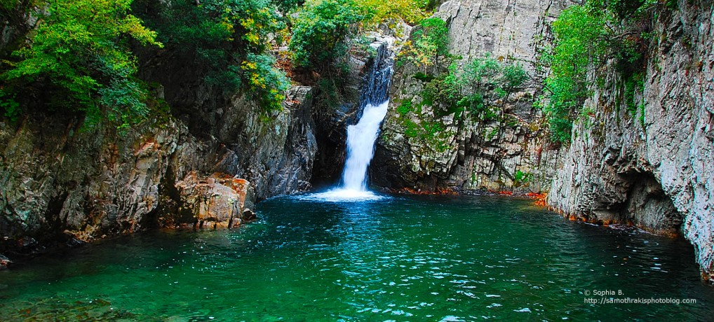
Introduction
Location : South-eastern Aegean
Total surface 178 km²
Cultural heritage :prehistoric times, Temple of the Great Gods
Natura 2000 protected areas
Biosphere reserve
Population : 2840 inhabitants
40% Tourism 45% Primary sector
EU subsidies to local farmers
The current issues of
Samothraki:
Social, Economical,Environmental
The idea of ESD centre

Slide 3
Methodology
Literature Review
Team-work & Brainstorming
Case Studies – Examples of good practices:
ESD in Urdaibai Biosphere Reserve at Basque Autonomous Country, Spain
Environmental Education Centre in Czech Republic, Kladno
The Regional Environmental Centre for Central and Eastern Europe (REC)
The Toohey Forest Environmental Education Centre (Department of Griffith University EcoCentre)

Slide 4
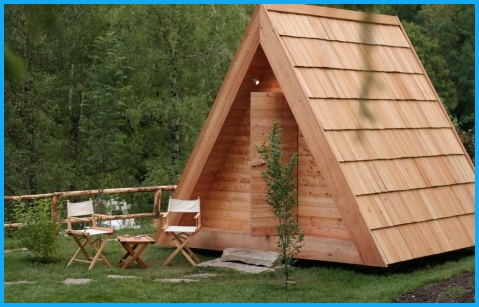
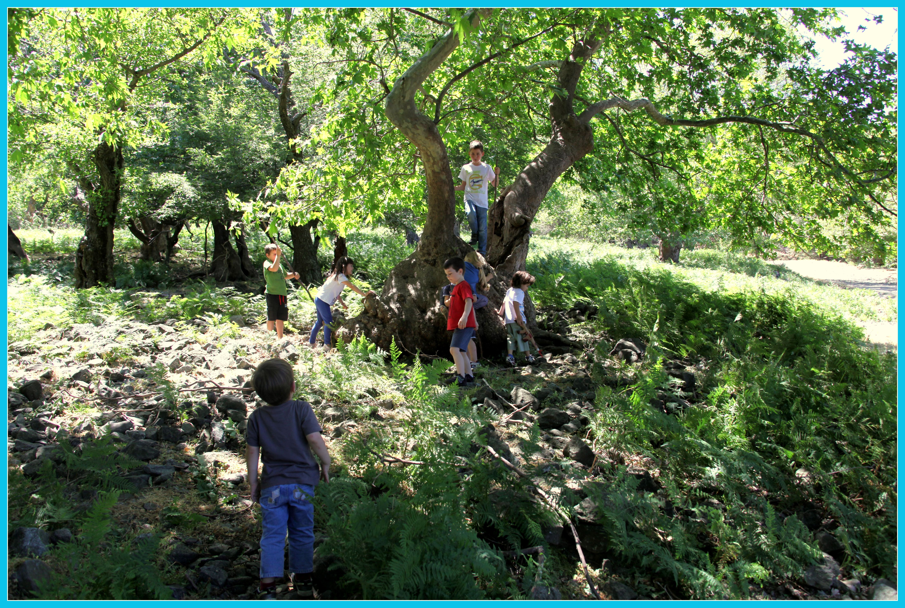
Research
The ESD center’s sustainable vision
Main activities
Materials used
Evaluation
Funding (2 steps)

Slide 5
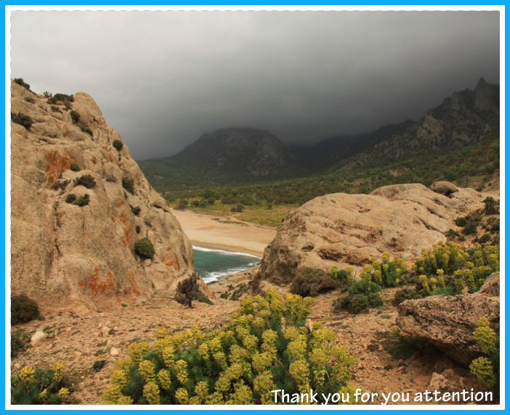
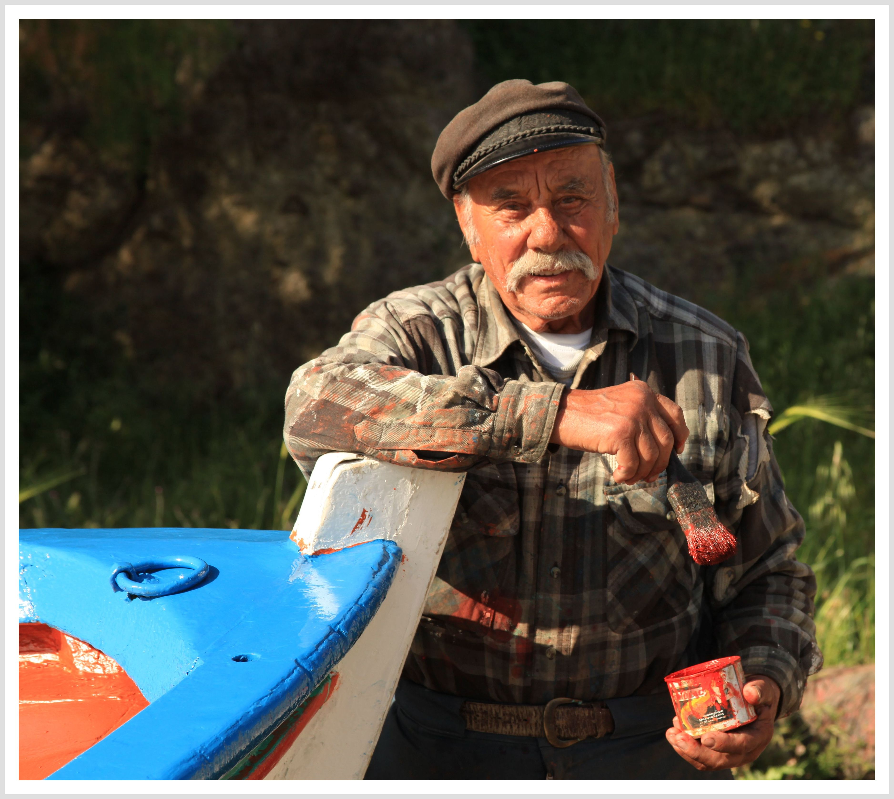
Conclusions
Identified ecology related issues
The ESD centre’s potential and main mission
Educational approach: based on supporting and revealing the knowledge of the local people
Further implications

